Slide 1

Building an E-commerce Presence: Web Sites, Mobile Sites, and Apps

Slide 2
Imagine Your E-commerce Presence
What’s the idea?
Vision includes:
Mission statement
Target audience
Intended market space
Strategic analysis (SWOT)
Internet marketing matrix
Development timeline and preliminary budget

Slide 3
Imagine Your E-commerce Presence (cont.)
Where’s the money?
Business model(s):
Portal, e-tailer, content provider, transaction broker, market creator, service provider, community provider
Revenue model(s):
Advertising, subscriptions, transaction fees, sales, and affiliate revenue

Slide 4
Imagine Your E-commerce Presence (cont.)
Who and where is the target audience?
Describing your audience
Demographics
Age, gender, income, location
Behavior patterns (lifestyle)
Consumption patterns (purchasing habits)
Digital usage patterns (consumer actions on the web)
Content creation patterns (blogs, Facebook)
Buyers’ personas and characteristics

Slide 5
Imagine Your E-commerce Presence (cont.)
Characterize the marketplace
Demographics
Size, growth, changes
Structure
Competitors
Suppliers
Substitute products
Where is the content coming from?
Static or dynamic web pages?

Slide 6
Imagine Your E-commerce Presence (cont.)
Know yourself—SWOT analysis
Develop an e-commerce presence map
Develop a timeline: Milestones
How much will this cost?
Simple Web sites: up to Birr 25000
Small Web start-up: Birr 50,000 to $100,000
Large corporate site: Birr 100,000+

Slide 7
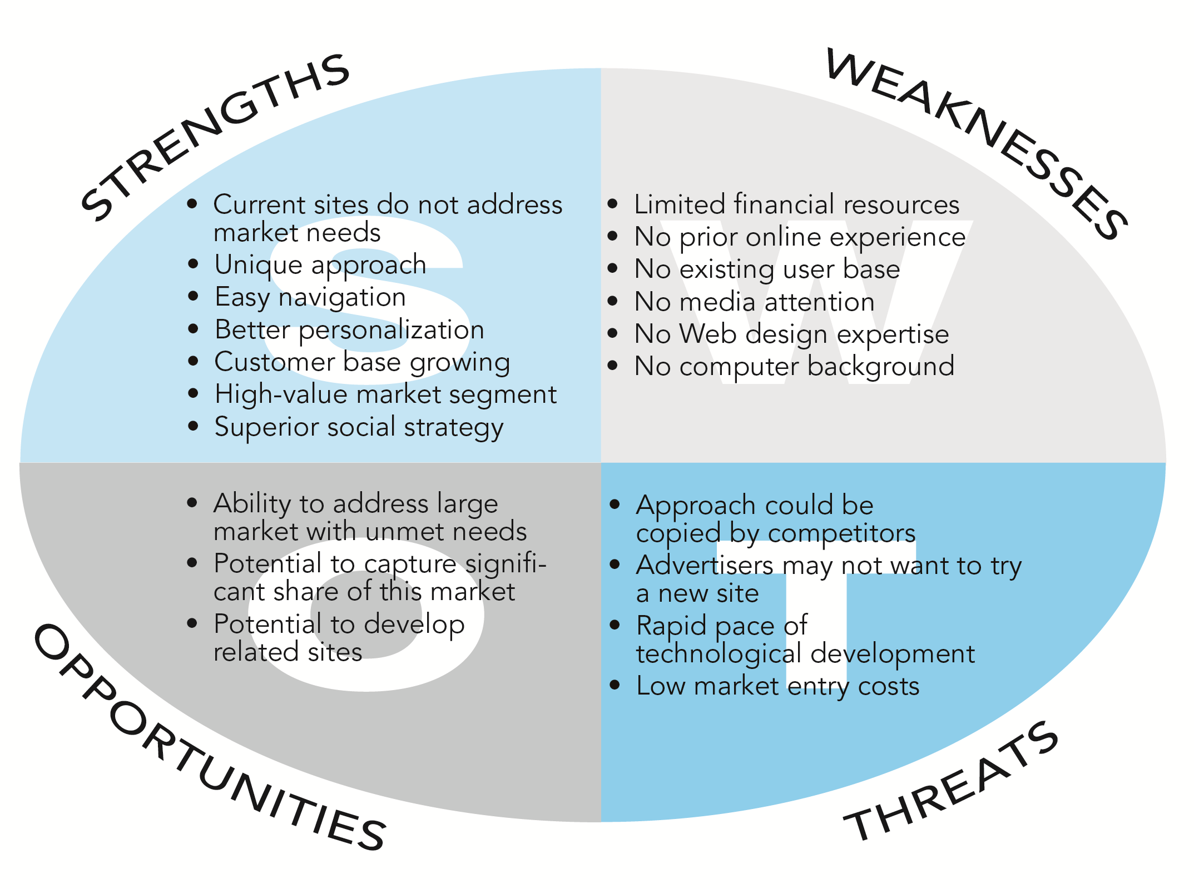
SWOT Analysis

Slide 8
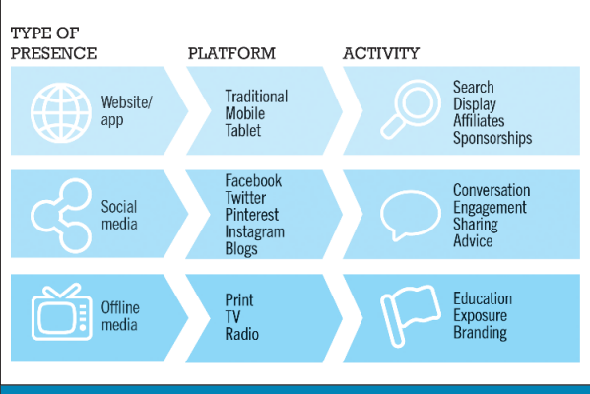
E-commerce Presence Map

Slide 9
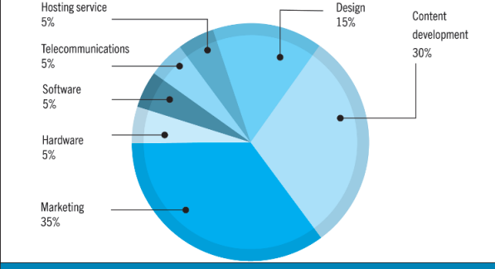
Components of a website budget

Slide 10
Building an E-commerce Site: A Systematic Approach
Most important management challenges:
Developing a clear understanding of business objectives
Knowing how to choose the right technology to achieve those objectives

Slide 11
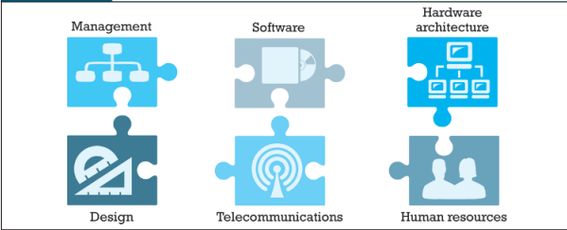
Pieces of the Site-Building Puzzle
Main areas where you will need to make decisions:
Human resources and organizational capabilities
Creating team with skill set needed to build and manage a successful site
Hardware/Software
Telecommunications
Site design

Slide 12
The Systems Development Life Cycle
Methodology for understanding business objectives of a system and designing an appropriate solution
Five major steps:
Systems analysis/planning
Systems design
Building the system
Testing
Implementation

Slide 13
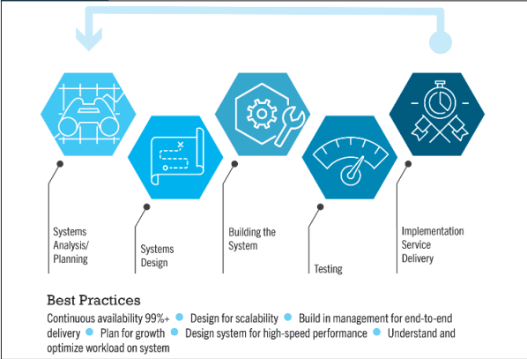
Web Site Systems Development Life Cycle

Slide 14
System Analysis/Planning
Business objectives:
List of capabilities you want your site to have
System functionalities:
List of information system capabilities needed to achieve business objectives
Information requirements:
Information elements the system must produce in order to achieve business objectives

Slide 15
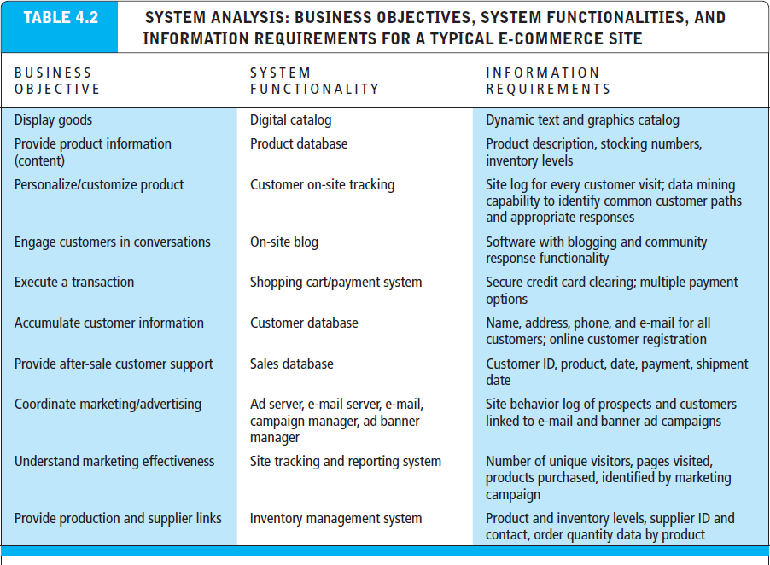

Slide 16
Systems Design: Hardware and Software Platforms
System design specification:
Description of main components of a system and their relationship to one another
Two components of system design:
Logical design
Data flow diagrams, processing functions, databases
Physical design
Specifies actual physical, software components, models, and so on

Slide 17
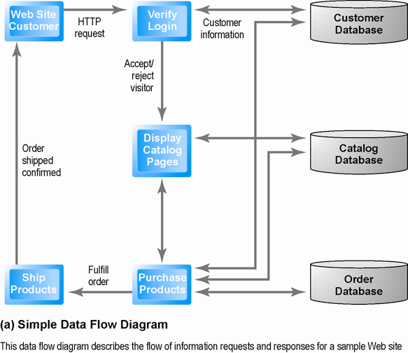
Logical Design for a Simple Web Site

Slide 18
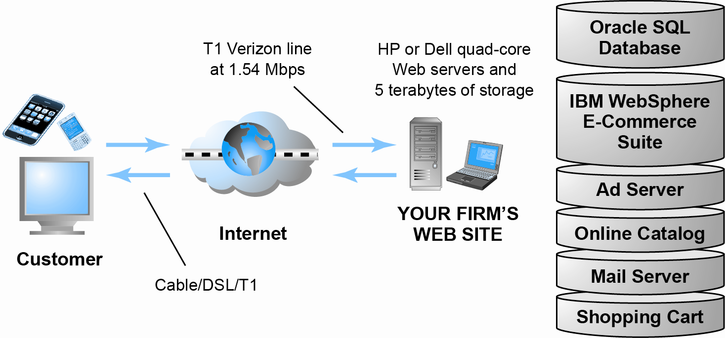
Physical Design for a Simple Web Site

Slide 19
Build/Host Your Own vs. Outsourcing
Outsourcing: Hiring vendors to provide services involved in building site
Build own vs. outsourcing:
Build your own requires team with diverse skill set; choice of software tools; both risks and possible benefits
Host own vs. outsourcing
Hosting: Hosting company responsible for ensuring site is accessible 24/7, for monthly fee
Co-location: Firm purchases or leases Web server (with control over its operation), but server is located at vendor’s facility

Slide 20
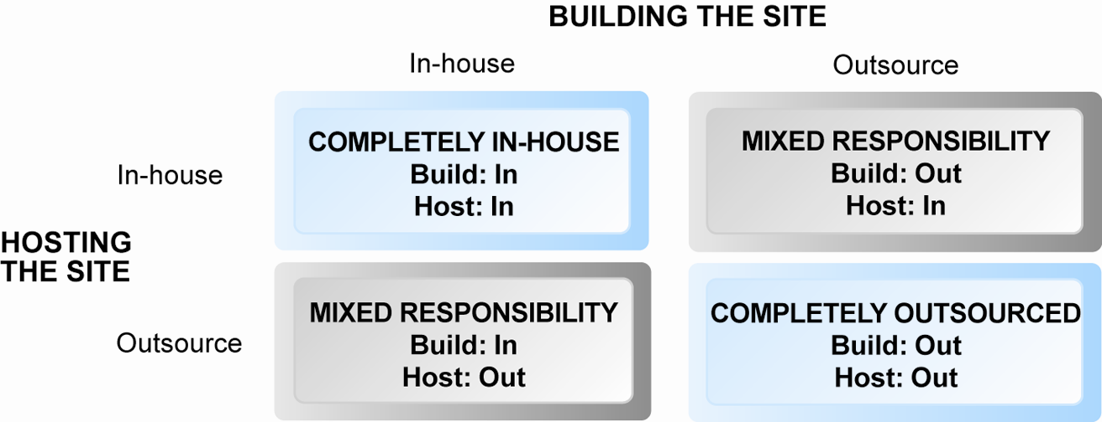
Choices in Building and Hosting

Slide 21
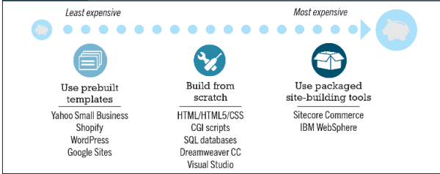
Spectrum of Web Tools for e-commerce Site

Slide 22
Hosting
Host your own site
Ownership of physical space
Located in own facility
Co-location
Purchase or lease physical space
Located in vendor’s facility
Cloud based services
Rent virtual space on your vendor’s infrastructure

Slide 23
Testing, Implementation, and Maintenance
Testing
Unit testing
System testing
Acceptance testing
Implementation and maintenance:
Maintenance is ongoing
Maintenance costs: Similar to development costs
Benchmarking

Slide 24
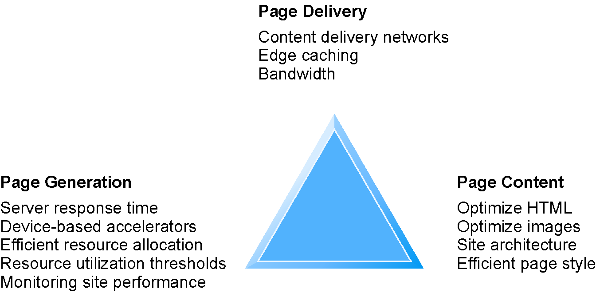
Factors in Web Site Optimization
Notes:
Edge caching refers to distributing content from local web servers to caching servers that are closer to the end users (i.e., near the edge)

Slide 25
Simple vs. Multi-tiered Web Site Architecture
System architecture
Arrangement of software, hardware, and tasks in an information system needed to achieve a specific functionality
Two-tier
Web server and database server
Multi-tier
Web application and other servers
Backend, legacy databases

Slide 26
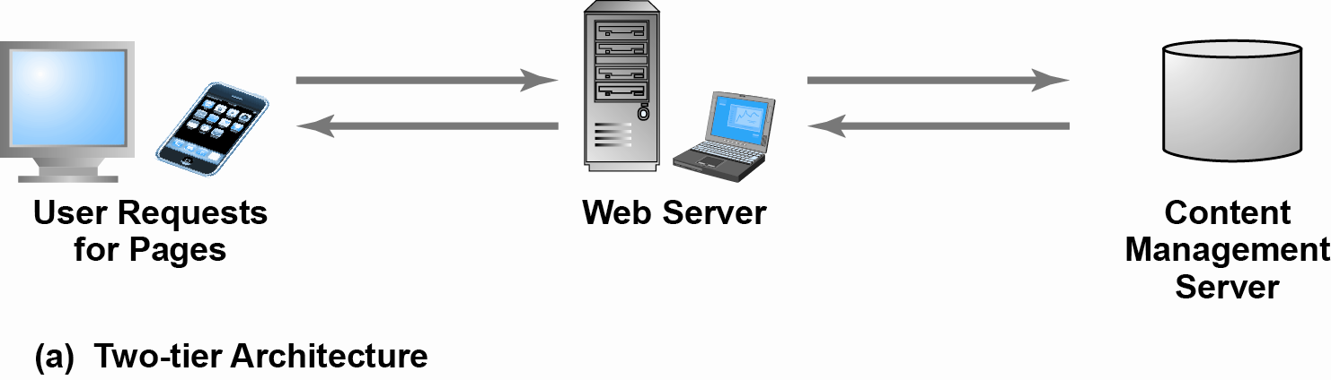
Two-Tier E-commerce Architecture

Slide 27
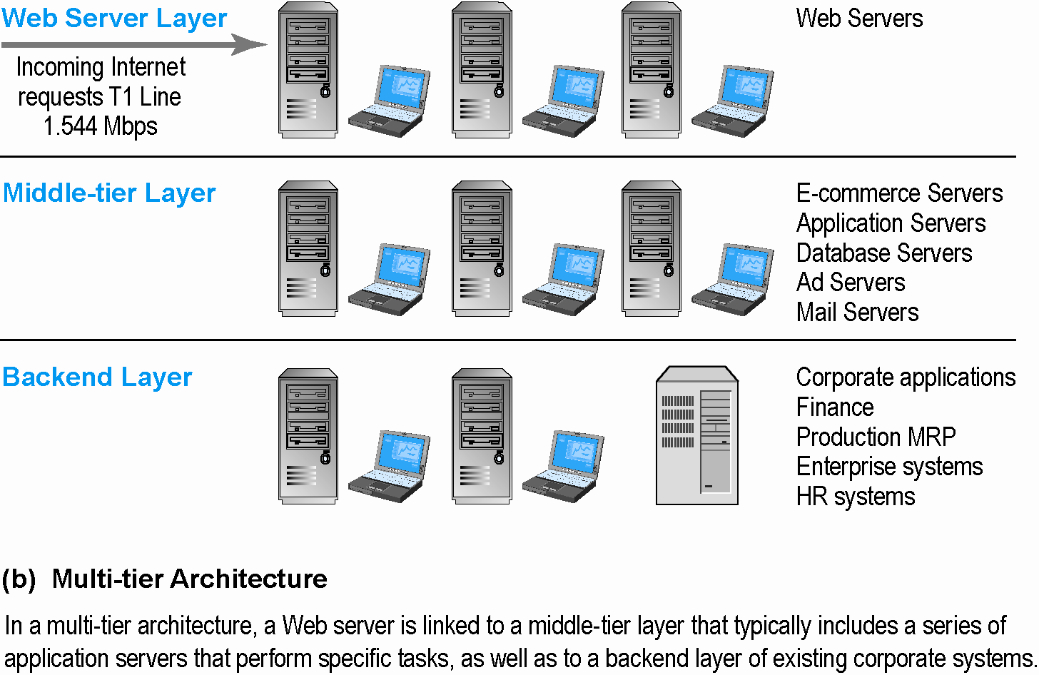
Multi-Tier E-commerce Architecture

Slide 28
Web Server Software
Apache
Leading Web server software (47% of market)
Works with UNIX, Linux operating systems
Comes loaded on IBM systems
Microsoft’s Internet Information Server (IIS)
Second major Web server software (20% of market)
Windows-based

Slide 29
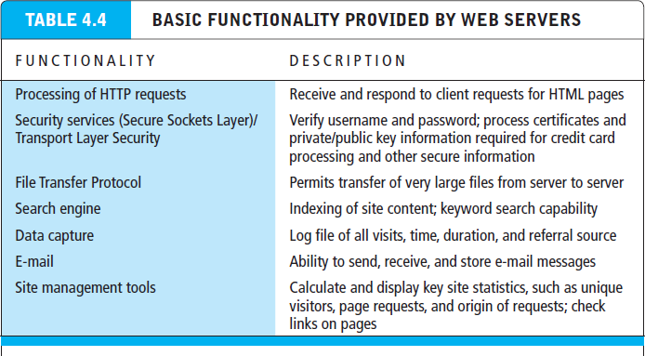

Slide 30
Site Management Tools
Basic tools
Included in all Web servers
Verify that links on pages are still valid
Identify orphan files
Third-party software for advanced management
Monitor customer purchases, marketing campaign effectiveness, and so on
WebTrends Analytics 10, Google Analytics

Slide 31
Dynamic Page Generation Tools
Dynamic page generation:
Page contents stored in databases as objects and fetched when needed
Lowers menu cost (cost of changing the price of goods/services)
Enables market segmentation
Common tools:
Common Gateway Interface (CGI) (offers a standard protocol for web servers to execute programs)
Active server pages (ASP) (Microsoft's server-side script engine that enables dynamically-generated web pages)
Java Server Pages (JSP) (same purpose as above)
Open Data Base Connectivity (ODBC), a std DB access method allows connections to any DB
Advantages
Lowers menu costs
Permits easy online market segmentation
Enables cost-free price discrimination
Enables content management system (CMS)

Slide 32
Application Servers
Web application servers:
Is a server program in a distributed network that provides the business logic or functionality required by a website. Often viewed as a 3 tier application.
It divides the application into
1ST tier: front end – web browser GUI
2nd middle tier: business logic
3rd tier: back end – DB and transaction server

Slide 33
E-commerce Merchant Server Software
Provides basic functionality for online sales
Online catalog
List of products available on Web site
Online shopping cart
Allows shoppers to set aside, review, edit selections, and then make purchase
Credit card processing
Typically works in conjunction with shopping cart
Verifies card and puts through credit to company’s account at checkout

Slide 34
Merchant Server Software Packages
Integrated environment that includes the functionality needed for ecommerce
Key factors in selecting a package
Functionality
Support for different business models
Business process modeling tools
Visual site management and reporting
Performance and scalability
Connectivity to existing business systems
Compliance with standards
Global and multicultural capability
Local sales tax and shipping rules

Slide 35
Web Services and Open-Source Options
Options for small firms
Hosted e-commerce sites
Offer site building tools and templates
Example: Yahoo’s Merchant Solutions
Open-source merchant server software
Enables you to build truly custom sites
Requires programmer with expertise, time

Slide 36
The Hardware Platform
Hardware platform:
Underlying computing equipment needed for e-commerce functionality
Objective:
Enough platform capacity to meet peak demand without wasting money
Important to understand the factors that affect speed, capacity, and scalability of a site

Slide 37
Right-Sizing Your Hardware Platform: The Demand Side
Customer demand:
Most important factor affecting speed of site
Factors in overall demand:
Number of simultaneous users in peak periods
Nature of customer requests (user profile)
Type of content (dynamic vs. static Web pages)
Required security
Number of items in inventory
Number of page requests (Google has 40,000 per sec)
Speed of legacy applications

Slide 38
Right-Sizing Your Hardware Platform: The Supply Side
Scalability:
Ability of site to increase in size as demand warrants
Ways to scale hardware:
Vertically
Increase processing power of individual components – e.g., using multiple processers, faster chips
Horizontally
Employ multiple computers to share workload
Improve processing architecture

Slide 39
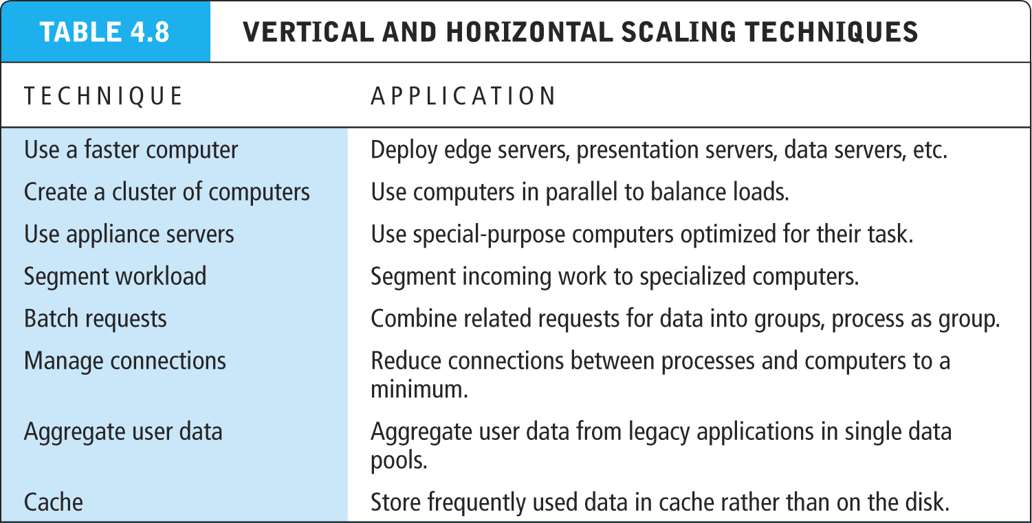

Slide 40
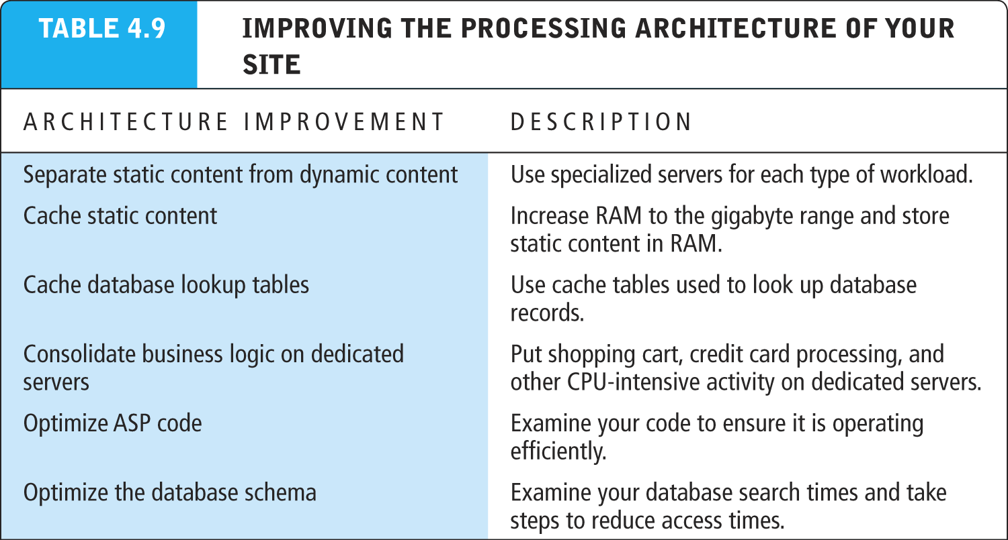

Slide 41
Other E-commerce Site Tools
Web site design: Basic business considerations
Enabling customers to find and buy what they need
Tools for Web site optimization
Search engine placement
Metatags and titles, help search engines find you
Identify market niches, and tailor site to them
Offer expertise such as white papers, industry analysis etc. to attract customers
Encourage links from other sites to yours
Buy Search engine keywords and ads
Use key words to suggest the location of your establishment

Slide 42
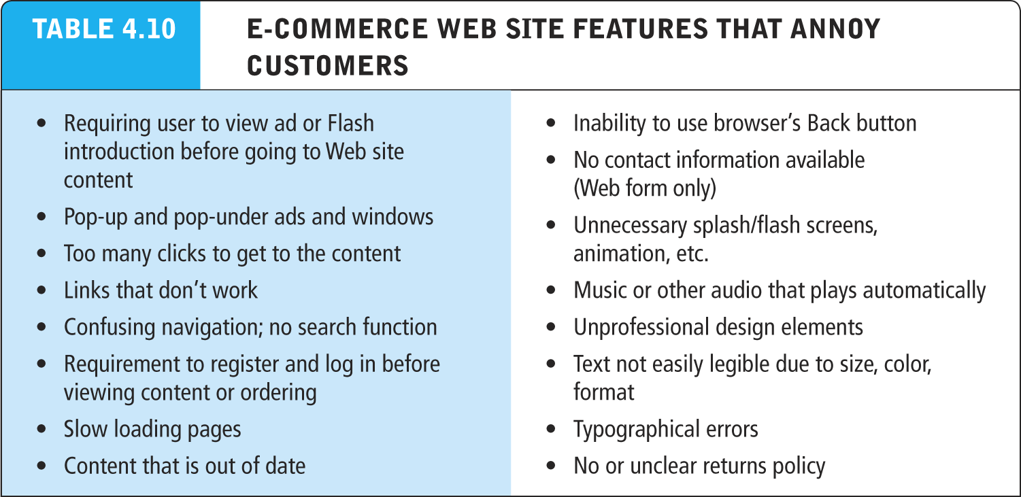

Slide 43
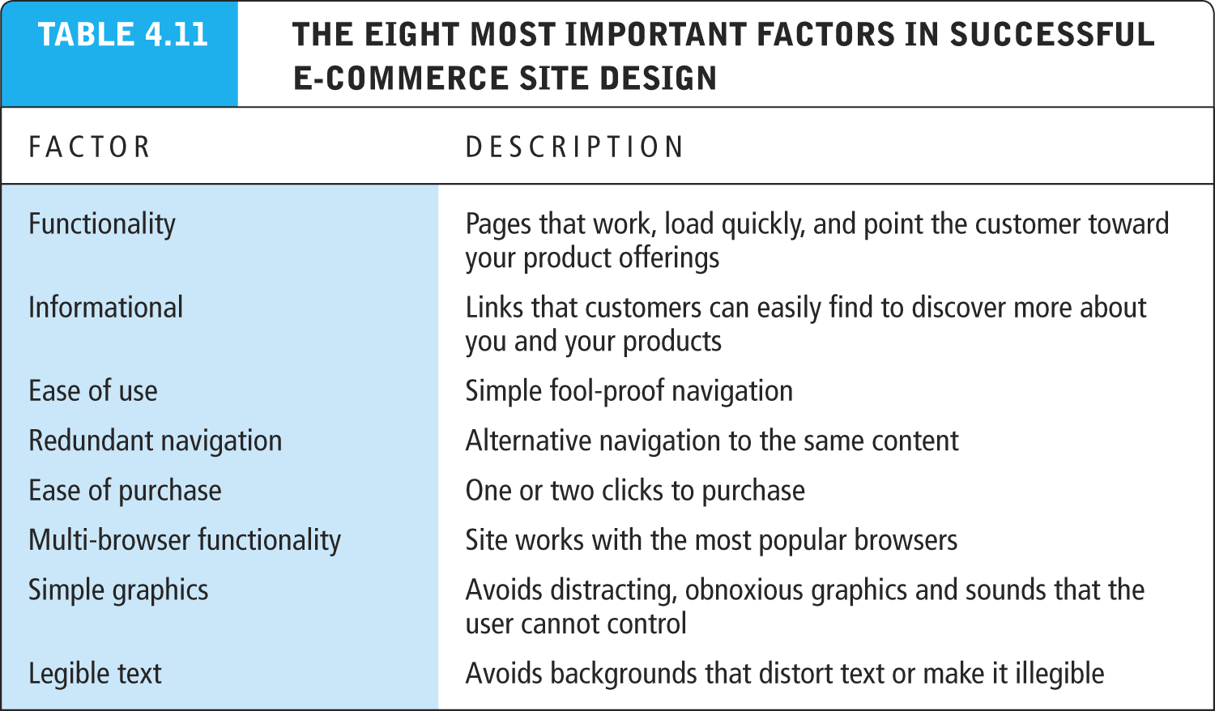

Slide 44
Tools for Interactivity and Active Content
CGI (Common Gateway Interface)
ASP (Active Server Pages)/ASP.NET
Java, JSP, and JavaScript (Sun)
ActiveX and VBScript (Microsoft)
ActiveX are technologies for content downloaded from a network, particularly from the World Wide Web.
ColdFusion (Adobe) rapid web application development platform
Web 2.0 design elements:
Widgets (small pieces of programming code)
mashups (functionality and data from one program used in another)

Slide 45
Personalization Tools
Personalization
Ability to treat people based on personal qualities and prior history with site
Customization
Ability to change the product to better fit the needs of the customer
Cookies
Primary method to achieve personalization
Amazon.com customizes the content of the homepage based on products you have viewed in the past

Slide 46
The Information Policy Set
Privacy policy
Set of public statements declaring how site will treat customers’personal information that is gathered by site
Accessibility rules
Set of design objectives that ensure disabled users can affectively access site

Slide 47
Developing a Mobile Web Site and Building Mobile Applications
Three types of m-commerce software
Mobile Web site
Browser-based Internet services accessed from handheld mobile devices
Mobile Web app built for a mobile web browser of a smart device (phone, tablet)
Native app designed specifically for mobile device
Planning and building mobile presence
Use systems analysis/design to identify unique and specific business objectives

Slide 48
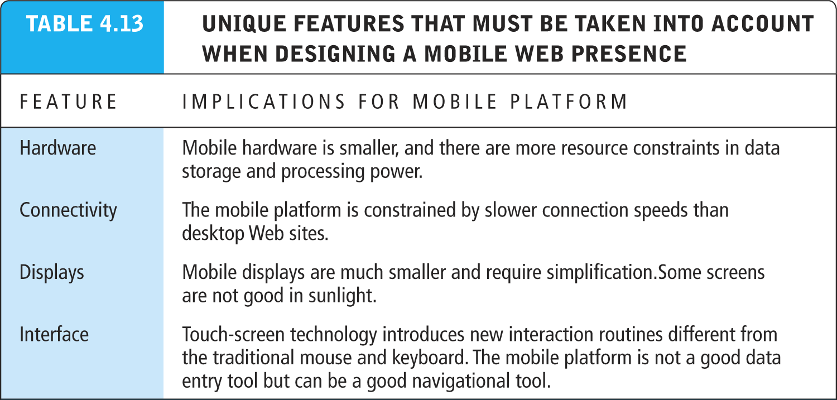

Slide 49
Developing a Mobile Web Presence
Design considerations
Platform constraints: Smartphone/tablet
Performance and cost
Mobile Web site:
Least expensive
Mobile app:
Can utilize browser API
Native app:
Most expensive; requires more programming

